Slide 1
Implement the buckets as linked lists. They are first-in, first-out. This will be useful later.
CountingSort:
9
6
3
5
2
1
2
2
1
2
3
5
6
9
1
2
3
4
5
6
7
8
9
Concatenate the buckets!
SORTED!
In time O(n).

Slide 2
Assumptions
Need to be able to know what bucket to put something in.
We assume we can evaluate the items directly, not just by comparison
Need to know what values might show up ahead of time.
Need to assume there are not too many such values.
2
12345
13
2¹⁰⁰⁰
50
100000000
1

Slide 3
RadixSort
For sorting integers up to size M
or more generally for lexicographically sorting strings
Can use less space than CountingSort
Idea: CountingSort on the least-significant digit first, then the next least-significant, and so on.

Slide 4
Step 1: CountingSort on least significant digit
21
345
13
101
50
234
1
1
101
234
345
50
13
21
0
1
2
3
4
5
6
7
8
9
50
21
101
1
13
234
345

Slide 5
Step 2: CountingSort on the 2nd least sig. digit
50
21
101
1
13
234
345
1
345
13
21
234
50
101
0
1
2
3
4
5
6
7
8
9
101
1
13
21
234
345
50

Slide 6
Step 3: CountingSort on the 3rd least sig. digit
101
1
13
21
234
345
50
50
21
13
234
345
1
101
0
1
2
3
4
5
6
7
8
9
1
13
21
50
101
234
345
It worked!!

Slide 7
Why does this work?
Original array:
21
345
13
101
50
234
1
Next array is sorted by the first digit.
50
21
101
1
13
234
345
50
21
101
1
13
234
345
Next array is sorted by the first two digits.
101
1
13
21
234
345
50
101
01
13
21
234
345
50
Next array is sorted by all three digits.
1
13
21
50
101
234
345
001
013
021
050
101
234
345
Sorted array

Slide 8
To prove this is correct…
What is the inductive hypothesis?
Original array:
21
345
13
101
50
234
1
Next array is sorted by the first digit.
50
21
101
1
13
234
345
50
21
101
1
13
234
345
Next array is sorted by the first two digits.
101
1
13
21
234
345
50
101
01
13
21
234
345
50
Next array is sorted by all three digits.
1
13
21
50
101
234
345
001
013
021
050
101
234
345
Sorted array

Slide 9
RadixSort is correct
Inductive hypothesis:
After the k’th iteration, the array is sorted by the first k least-significant digits.
Base case:
“Sorted by 0 least-significant digits” means not yet sorted, so the IH holds for k=0.
Inductive step:
TO DO
Conclusion:
The inductive hypothesis holds for all k, so after the last iteration, the array is sorted by all the digits. Hence, it’s sorted!

Slide 10
Inductive step
Inductive hypothesis:
After the k’th iteration, the array is sorted by the first k least-significant digits.
Need to show: if IH holds for k=i-1, then it holds for k=i.
Suppose that after the i-1’st iteration, the array is sorted by the first i-1 least-significant digits.
Need to show that after the i’th iteration, the array is sorted by the first i least-significant digits.
IH: this array is sorted by first digit.
050
021
101
002
013
234
345
002
EXAMPLE: i=2
234
345
101
013
021
050
0
1
2
3
4
5
6
7
8
9
101
002
013
021
234
345
050
Want to show: this array is sorted by 1st and 2nd digits.

Slide 11
Proof sketch… proof on next (skipped) slide
Want to show: after the i’th iteration, the array is sorted by the first i least-significant digits.
Let x=[x_{d}x_{d-1}…x₂x₁] and y=[y_{d}y_{d-1}…y₂y₁] be any x,y.
Suppose [x_{i}x_{i-1}…x₂x₁] < [y_{i}y_{i-1}…y₂y₁].
Want to show that x appears before y at end of i’th iteration.
CASE 1: x_{i}<y_{i}
x is in an earlier bucket than y.
Aka, we want to show that for any x and y so that x belongs before y, we put x before y.
IH: this array is sorted by first digit.
x
y
050
021
101
002
013
234
345
002
x
y
EXAMPLE: i=2
234
345
101
013
021
050
0
1
2
3
4
5
6
7
8
9
x
y
101
002
013
021
234
345
050
Want to show: this array is sorted by 1st and 2nd digits.

Slide 12
Proof sketch… proof on next (skipped) slide
Want to show: after the i’th iteration, the array is sorted by the first i least-significant digits.
Let x=[x_{d}x_{d-1}…x₂x₁] and y=[y_{d}y_{d-1}…y₂y₁] be any x,y.
Suppose [x_{i}x_{i-1}…x₂x₁] < [y_{i}y_{i-1}…y₂y₁].
Want to show that x appears before y at end of i’th iteration.
CASE 1: x_{i}<y_{i}
x is in an earlier bucket than y.
CASE 2: x_{i}=y_{i}
[x_{i-1}…x₂x₁] < [y_{i-1}…y₂y₁],
x and y in same bucket, but x was put in the bucket first.
Aka, we want to show that for any x and y so that x belongs before y, we put x before y.
IH: this array is sorted by first digit.
y
050
021
x
101
002
013
234
345
y
002
EXAMPLE: i=2
234
345
101
x
013
021
050
0
1
2
3
4
5
6
7
8
9
x
y
101
002
013
021
234
345
050
Want to show: this array is sorted by 1st and 2nd digits.

Slide 13
Want to show: after the i’th iteration, the array is sorted by the first i least-significant digits.
SLIDE SKIPPED IN CLASS. Here for reference.
Let x=[x_{d}x_{d-1}…x₂x₁] and y=[y_{d}y_{d-1}…y₂y₁] be any x,y.
Suppose [x_{i}x_{i-1}…x₂x₁] < [y_{i}y_{i-1}…y₂y₁].
Want to show that x appears before y at end of i’th iteration.
CASE 1: x_{i}<y_{i}.
x appears in an earlier bucket than y, so x appears before y after the i’th iteration.
CASE 2: x_{i}=y_{i}.
x and y end up in the same bucket.
In this case, [x_{i-1}…x₂x₁] < [y_{i-1}…y₂y₁], so by the inductive hypothesis, x appeared before y after i-1’st iteration.
Then x was placed into the bucket before y was, so it also comes out of the bucket before y does.
Recall that the buckets are FIFO queues.
So x appears before y in the i’th iteration.

Slide 14
Inductive step
Inductive hypothesis:
After the k’th iteration, the array is sorted by the first k least-significant digits.
Need to show: if IH holds for k=i-1, then it holds for k=i.
Suppose that after the i-1’st iteration, the array is sorted by the first i-1 least-significant digits.
Need to show that after the i’th iteration, the array is sorted by the first i least-significant digits.
IH: this array is sorted by first digit.
050
021
101
002
013
234
345
002
EXAMPLE: i=2
234
345
101
013
021
050
0
1
2
3
4
5
6
7
8
9
101
002
013
021
234
345
050
Want to show: this array is sorted by 1st and 2nd digits.

Slide 15
RadixSort is correct
Inductive hypothesis:
After the k’th iteration, the array is sorted by the first k least-significant digits.
Base case:
“Sorted by 0 least-significant digits” means not sorted, so the IH holds for k=0.
Inductive step:
TO DO
Conclusion:
The inductive hypothesis holds for all k, so after the last iteration, the array is sorted by all the digits. Hence, it’s sorted!

Slide 16
What is the running time?
for RadixSorting numbers base-10.
Suppose we are sorting n d-digit numbers (in base 10).
How many iterations are there?
How long does each iteration take?
What is the total running time?
e.g., n=7, d=3:
021
345
013
101
050
234
001

Slide 17
What is the running time?
for RadixSorting numbers base-10.
Suppose we are sorting n d-digit numbers (in base 10).
How many iterations are there?
d iterations
How long does each iteration take?
Time to initialize 10 buckets, plus time to put n numbers in 10 buckets. O(n).
What is the total running time?
O(nd)
e.g., n=7, d=3:
021
345
013
101
050
234
001

Slide 18
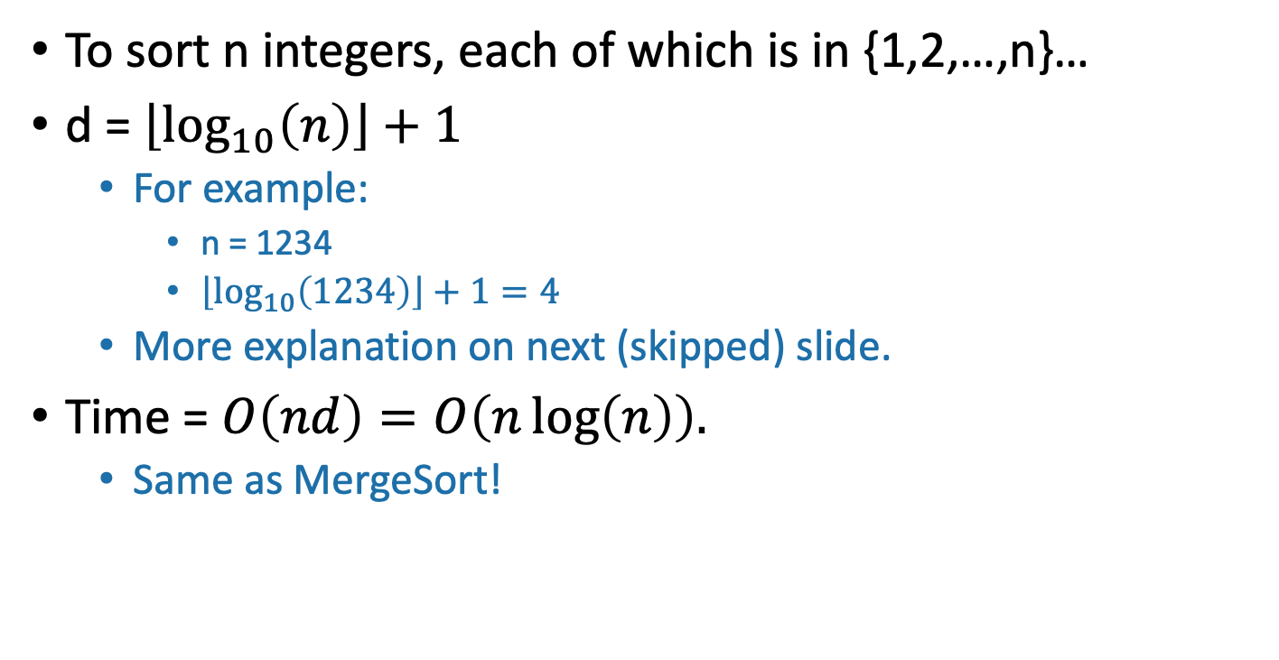
This doesn’t seem so great
To sort n integers, each of which is in {1,2,…,n}…
d = $\left\lfloor \log_{10}\left(n\right)\right\rfloor +1$
For example:
n = 1234
$\left\lfloor \log_{10}\left(1234\right)\right\rfloor +1=4$
More explanation on next (skipped) slide.
Time = $O\left(nd\right)=O\left(n\log\left(n\right)\right).$
Same as MergeSort!

Slide 19
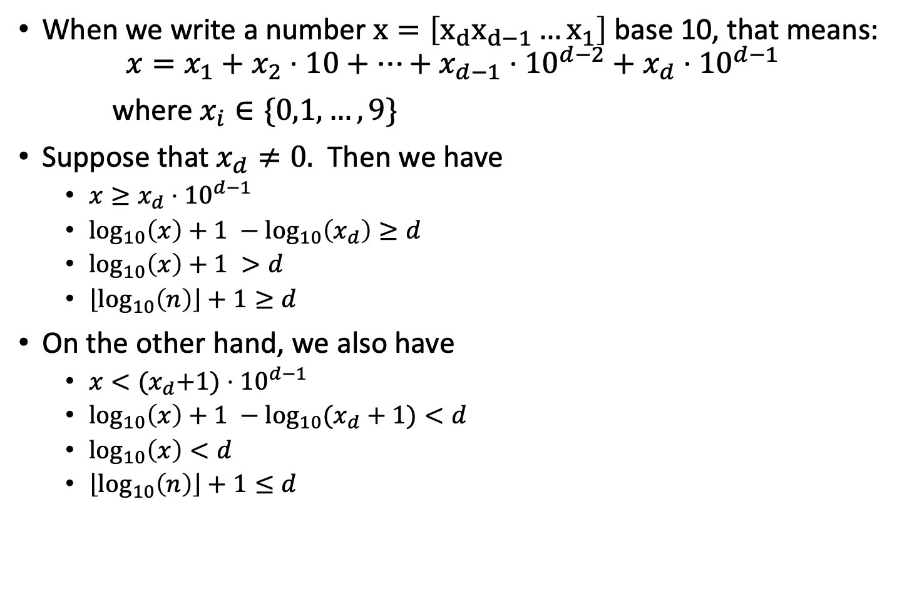
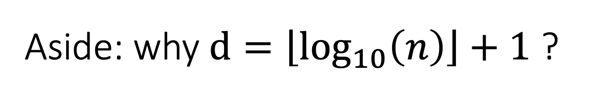


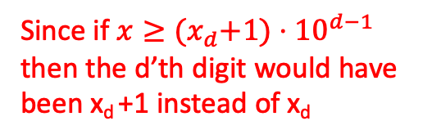
Aside: why $d=\left\lfloor \log_{10}\left(n\right)\right\rfloor +1$ ?
Slide skipped in class
When we write a number $x=\left[x_{d}x_{d−1}…x_{1}\right]$ base 10, that means:
$$x=x_{1}+x_{2}⋅10+⋯+x_{d−1}⋅{10}^{d−2}+x_{d}⋅{10}^{d−1}$$
where $x_{i}∈\{0,1,…,9\}$
Suppose that $x_{d}≠0.$ Then we have
$x≥x_{d}⋅{10}^{d−1}$
$\log_{10}\left(x\right)+1 −\log_{10}\left(x_{d}\right)≥d$
$\log_{10}\left(x\right)+1 >d$
$\left\lfloor \log_{10}\left(n\right)\right\rfloor +1≥d$
On the other hand, we also have
$x<{(x}_{d}+1)⋅{10}^{d−1}$
$\log_{10}\left(x\right)+1 −\log_{10}{(x_{d}+1)}<d$
$\log_{10}\left(x\right)<d$
$\left\lfloor \log_{10}\left(n\right)\right\rfloor +1≤d$
Since x is bigger than just the last term in that sum!
(take logs of both sides and rearrange)
$\log_{10}\left(x_{d}\right)> 0$since $x_{d}>0$
Since d is an integer
Since if $x≥{(x}_{d}+1)⋅{10}^{d−1}$ then the d’th digit would have been x_{d} +1 instead of x_{d}
(take logs of both sides and rearrange)
$\log_{10}\left(x_{d}+1\right)≤1$since $x_{d}<10$
Since d is an integer

Slide 20
Can we do better?
RadixSort base 10 doesn’t seem to be such a good idea…
But what if we change the base? (Let’s say base r)
We will see there’s a trade-off:
Bigger r means more buckets
Bigger r means fewer digits

Slide 21
Example: base 100
Original array:
21
345
13
101
50
234
1

Slide 22
Example: base 100
Original array:
0021
0345
0013
0101
0050
0234
0001
100 buckets:
…
…
…
0001
0101
0234
0050
00
01
02
34
50
98
99
0101
0001
0013
0021
0234
0345
0050

Slide 23
Example: base 100
0101
0001
0013
0021
0234
0345
0050
100 buckets:
0050
0021
…
…
0013
0001
0101
0234
0345
00
01
02
03
50
98
99
0001
0013
0021
0050
0101
0234
0345
Sorted!

Slide 24
Example: base 100
Original array
0021
0345
0013
0101
0050
0234
0001
0101
0001
0013
0021
0234
0345
0050
0001
0013
0021
0050
0101
0234
0345
Sorted array
Base 100:
d=2, so only 2 iterations.
100 buckets
Base 10:
d=3, so 3 iterations.
10 buckets
vs.
Bigger base means more buckets but fewer iterations.

Slide 25
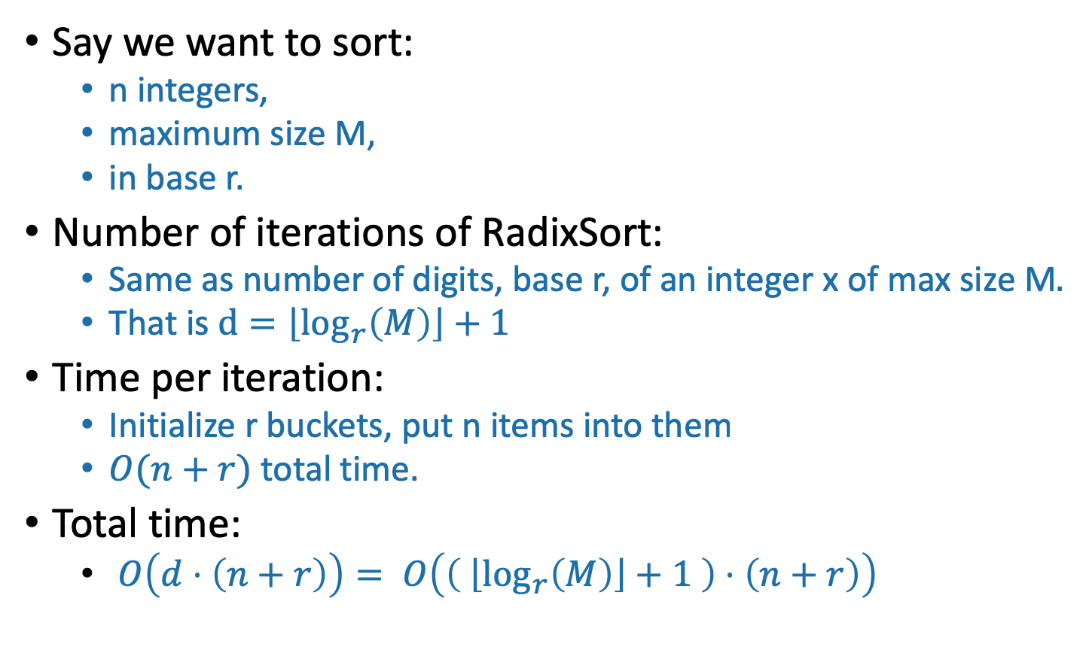
General running time of RadixSort
Say we want to sort:
n integers,
maximum size M,
in base r.
Number of iterations of RadixSort:
Same as number of digits, base r, of an integer x of max size M$.$
That is $d=\left\lfloor \log_{r}\left(M\right)\right\rfloor +1$
Time per iteration:
Initialize r buckets, put n items into them
$O(n+r)$ total time.
Total time:
$O\left(d⋅\left(n+r\right)\right)= O\left(\left( \left\lfloor \log_{r}\left(M\right)\right\rfloor +1 \right)⋅\left(n+r\right)\right)$
Convince yourself that this is the right formula for d.

Slide 26

Trade-offs
Running time: $O\left(\left( \left\lfloor \log_{r}\left(M\right)\right\rfloor +1 \right)⋅\left(n+r\right)\right)$
Given n, M, how should we choose r?
Looks like there’s some sweet spot:

Slide 27
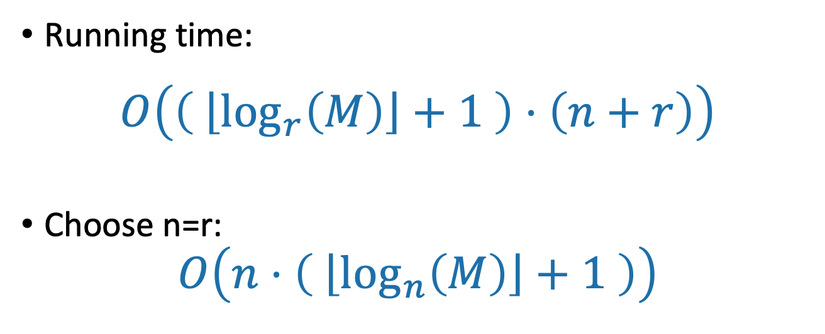
A reasonable choice: r=n
Running time:
$$O\left(\left( \left\lfloor \log_{r}\left(M\right)\right\rfloor +1 \right)⋅\left(n+r\right)\right)$$
Choose n=r:
$$O\left(n⋅\left( \left\lfloor \log_{n}\left(M\right)\right\rfloor +1 \right)\right)$$
Intuition: balance n and r here.
Choosing r = n is pretty good. What choice of r optimizes the asymptotic running time? What if I also care about space?

Slide 28
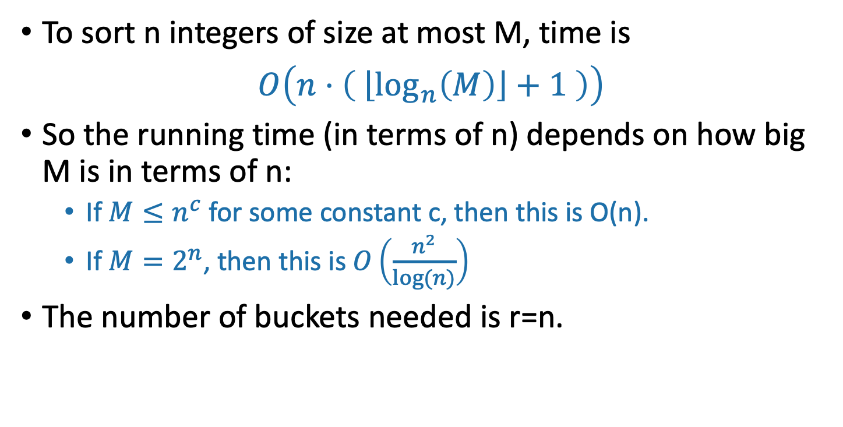
Running time of RadixSort with r=n
To sort n integers of size at most M, time is
$O\left(n⋅\left( \left\lfloor \log_{n}\left(M\right)\right\rfloor +1 \right)\right)$
So the running time (in terms of n) depends on how big M is in terms of n:
If $M≤n^{c}$ for some constant c, then this is O(n).
If $M=2^{n}$, then this is $O\left(\frac{n^{2}}{log⁡(n)}\right)$
The number of buckets needed is r=n.

